Slide 1
Redesigning WebSTAC
Milestone 2

Slide 2
Project Goals
Design a UI for students to enroll for classes, view their schedule
Project was inspired by WebSTAC’s capabilities
However, the project is redesigned to be a ground-up, not to simply “fix” WebSTAC or even have all of its features
Scope of project is simply registration, other aspects covered by WebSTAC are beyond our focus

Slide 3
Insights from Milestone 1
Asked students for insights about their thought process while enrolling for courses
Students weighed possible courses based on several factors:
Class size/capacity
Time of day
Meeting requirements
Opinions of previous students
Many of these features are already a part of WebSTAC
Newly requested features include the ability to leave reviews for courses
Useful for students registering in later semesters

Slide 4
Initial Paper Prototype Features
Initially, we wished to have a simple, straightforward, and clean interface
Inspired by the Google homepage
Main focus upon a central search bar for classes, with navigation links along the top
Students would have an account page, where they can view course schedule, their audit, academic calendar, course reviews
Registration and searching for courses similar to WebSTAC
Courses would display schedule, location, professor, prior reviews, class size
Search filters would be added for these parameters

Slide 5
Paper Prototype Interview Process
Three rounds of testing, three interviewees each
Asked each user to perform seven tasks
Tasks were chosen to test commonly used features and to maximize number of paths to various pages
Login, view your account
Search by name for a given course
Find your current class schedule, view a course’s details
Give a review for a current course
Find courses in a department that aren’t full
Drop a current course
Choose courses for registration, complete registration process

Slide 6
Interviews - Round 1
Issues during testing
Labelling the search page as “home” confused users
Some issues even noticing navigational bar
Users were confused on process to add courses for registration
Some discussion on whether search bar was an effective main page
Changes made for Round 2 Paper Prototype
Renamed “home” links to “search” to better clarify their use
Added “remove course” buttons to registration confirmation page
Navigational bar complaints were more an aesthetic complaint, but we somewhat enlarged them for easier viewing on paper
Elected to keep search bar as main page, pending additional user input

Slide 7
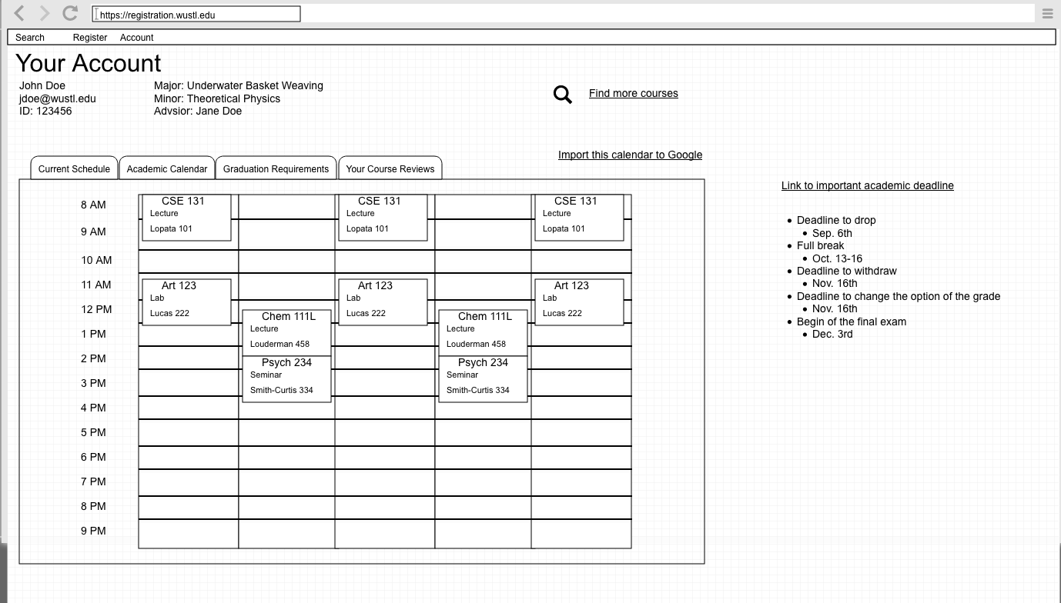
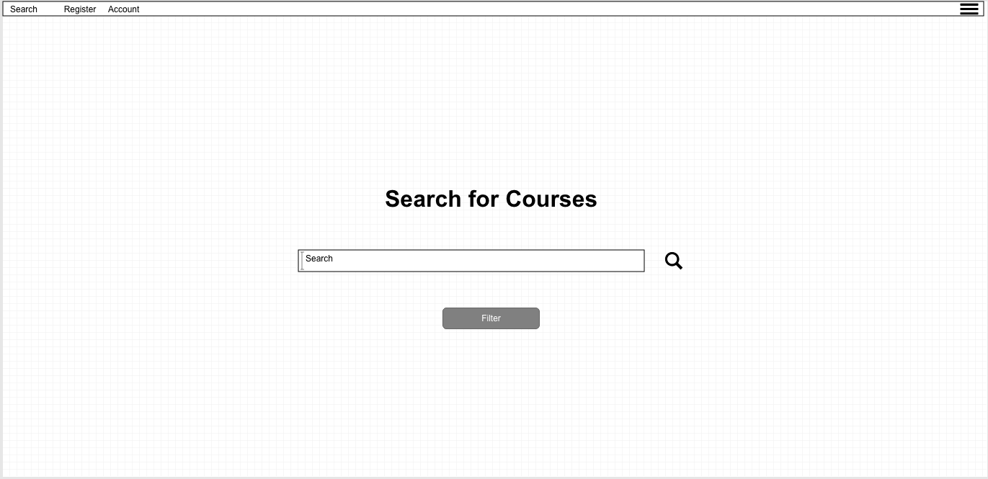

Slide 8
Interviews - Round 2
Complaints and Concerns
Additional suggestions to use account page as home page
Suggestions to remove very first “click to login” button
Add additional filters, such as “Prerequisites Met” or “200-299 level”
Wanted ability to view calendar in weekly along with monthly views
Confusion on some UI elements, such as “+” button
Changes made for Round 3 Prototype
Added weekly/monthly options for calendar
Additional filters added
“Drop course confirmation” changed to a popup, rather than its own page
Elected to keep the “click to login” button, matches with WebSTAC and BlackBoard behavior
Open to changing based on future user input

Slide 9
Interviews - Round 3
Complaints and Concerns
Additional request to remove “click to login” button
Suggestions on different options for main page
Suggestions to use/sync with Google calendar
Alerts for upcoming academic dates (drop, withdraw, etc.)
Changes made for future prototypes
Slight changes to registration wishlist navigation
Added popups for viewing alerts/notifications
Most suggestions at this stage focused on future features rather than issues with current prototype

Slide 10
Conclusions
Some suggestions useful to note, but aren’t relevant to this stage of the project
Ex. Usage of Google Calendar
Majority of changes focused on ease of locating course information and viewing personal info
Some debate over placement of pages, which page should function as the ‘main page’ of the site
Having a login button is surprisingly controversial

Slide 11
Future Plans
Make a functional prototype!
Current prototype layout seems easy to navigate, should form good basis for interactive prototype
We received some aesthetic and interactivity suggestions that can be revisited at later stages of the project
Focusing only on registration seems to be a good subset of WebSTAC to try and optimize

